Slide 1

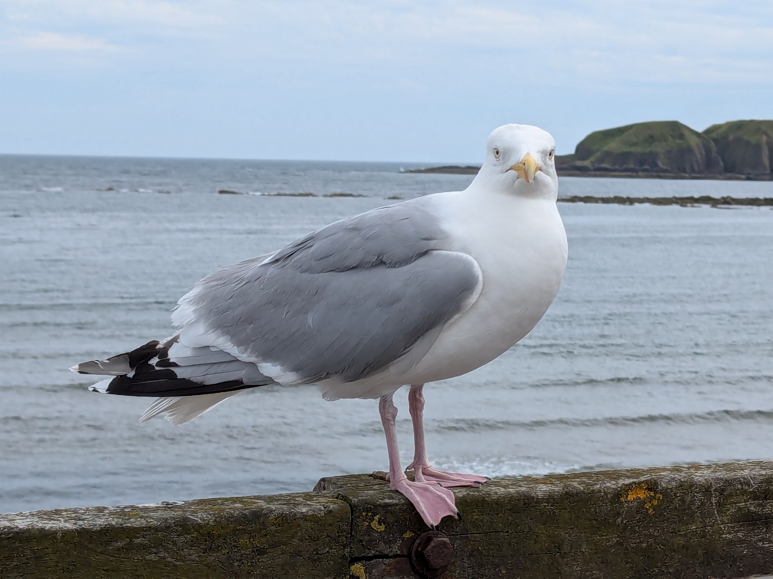

Living with Gulls

Slide 2
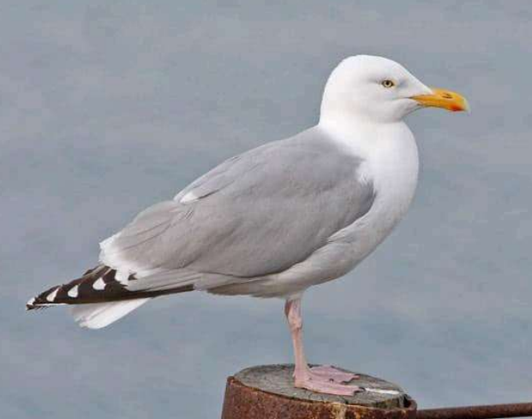
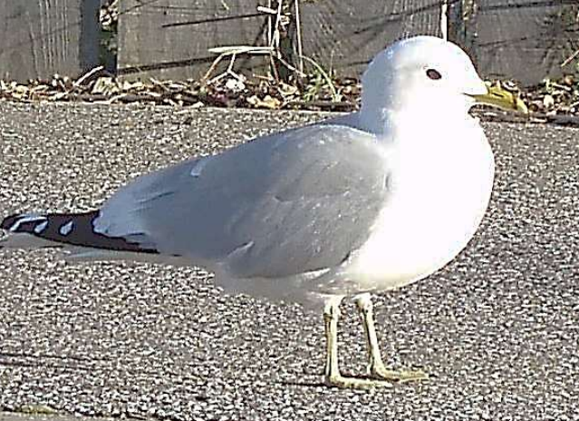
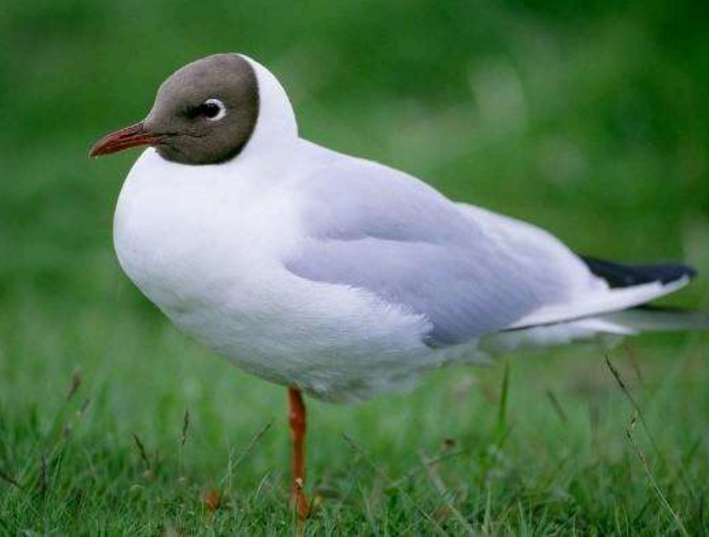
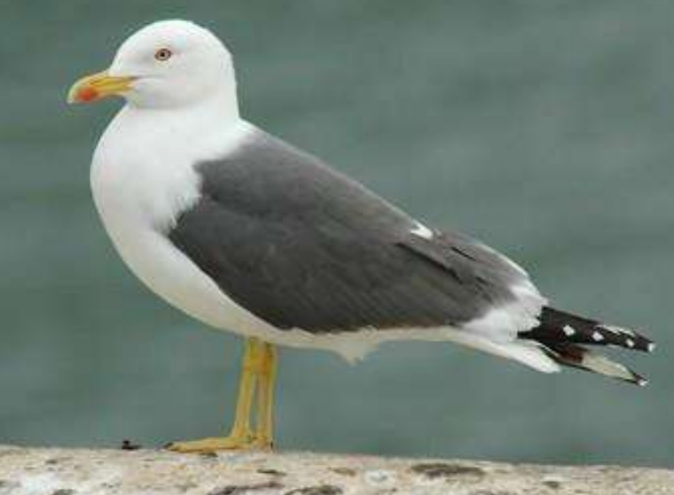
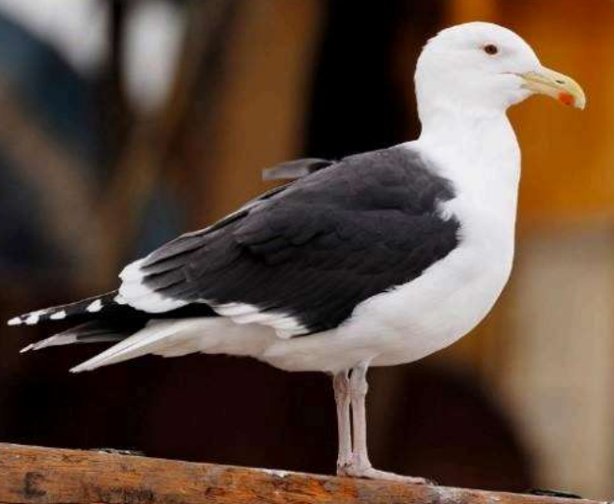
The gulls you are most likely to see are:-
*Herring Gull - UK has 43% of the global population and Scotland has half of those.
*Common Gull - Scotland has 89% of UK population.
*Black headed Gull
*Lesser black backed gull
*Great black backed gull - Scotland has 48% of UK population
Herring Gull
Common Gull
Black Headed Gull
Lesser Black Backed Gull
Greater Black
Backed Gull
Source and photos: NatureScot

Slide 3
Are there more gulls than ever?
Population size of Gulls in 2023 compared to 2019 levels
Common Black Herring Lesser black Great black
Gull headed Gull backed backed Gull
53%
75%
44%
48%
63%
Gull numbers
Are
DECREASING
Source: NatureScot

Slide 5
Gulls are protected
Although there doesn’t seem to be a shortage of gulls in Aberdeenshire their overall population sizes mean that the gulls are either on the amber or red bird conservation list and because of this it is ILLEGAL to harm a gull. It is illegal to remove a nest whilst it is being used, destroy eggs or move chicks without a license as per The Wildlife and Countryside Act 1981.
Aberdeenshire Council does not have any legal powers to deal with gulls or the feeding of gulls. It can only offer advice and work with communities to try and solve any issues that occur. Aberdeenshire Council like homeowners are responsible for protecting their property.

Slide 6




Why are gulls living in our towns
We provide ready to go meals in towns. Gulls can utilise a wide variety of food. They are clever and will even go into shops to take packets of crisps! They enjoy the food people feed them or the food which is not disposed of properly.
We provide ideal nesting areas on roofs where there are less predators and good shelter.
They have a relatively safe place to nest and a more readily available food source and once gulls breed and if they like the area they tend to return and build up colonies.

Slide 7

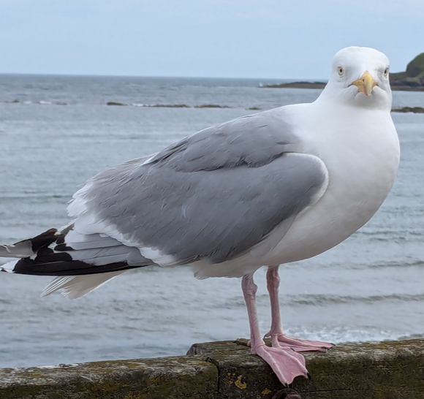
Life cycle of a gull
February - March
Gull returns to breeding colonies.
Time to take preventive measures
To stop gulls nesting on your property.
APRIL
Nests set up and first eggs laid by the end of April.
Apply for a licence from NatureScot to remove nests or eggs if it’s for a public health or health and safety reason.
November to January
Gulls remain in winter locations.
September to October
Gulls disperse to their winter locations which can mean they stay in Scotland.
May to June
Incubation of eggs (28days)
Chick hatching and growth.
July to August
Chicks fledge after 25-30days. Adult gulls start to leave colonies.
Very protective parents. Will dive at people until their chicks are fully grown which takes a few weeks.

Slide 8
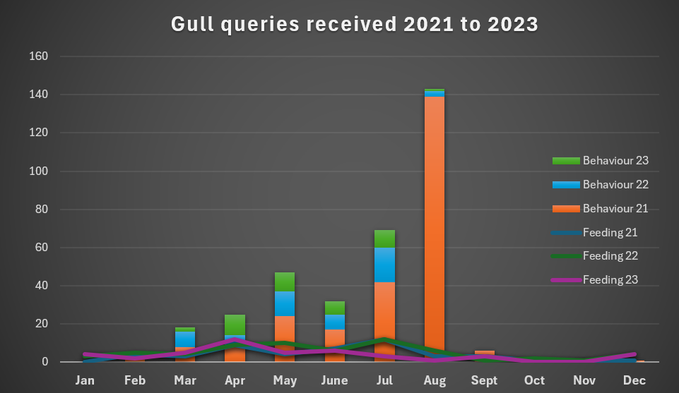
Feb + Mar Return to
breeding ground
Nests
Eggs
Chicks
Fledge
Return to winter feeding grounds

Slide 9
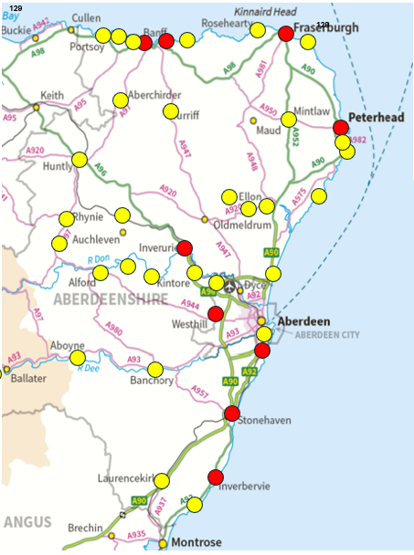
Not just a costal issue. The map shows
areas where gulls have caused issues
Red dots make up 75% of issues recorded

Slide 10
What can WE do to persuade gulls to move to an area where they can breed in peace and not impact on us.
Work together as a community
Learn more about gulls, what to expect and when
As a last resource apply for a license from Nature Scot if it’s a public health or safety issue after preventative measures have been taken
Take preventative measures to make your property less appealing to nest on
Only use bird feeders designed for garden birds or as a compromise just feed birds in the winter months when there is less food available.
Dispose of food waste securely in bins

Slide 11
NatureScot will only issue a license if there is a risk to public health or safety and preventative measure have been taken.
Diving Bombing
This is considered when it is a vulnerable person or group of persons, for example someone who is unable to defend themselves due to working at height, or due to certain forms of disability.
Noise disturbance
This is considered under exceptional circumstances and will require clear well evidenced reasoning why there is no other suitable alternative to licencing.
Droppings contaminating foodstuffs
This qualifies as a risk where the gull droppings are directly falling into or on food processing or preparation areas or accumulating in high quantities in dining areas.
They will assess each case by case. For a more in-depth explanation on licensing, please see NatureScot’s gull management page: https://www.nature.scot/doc/guidance-gull-management
Source: NatureScot

Slide 12
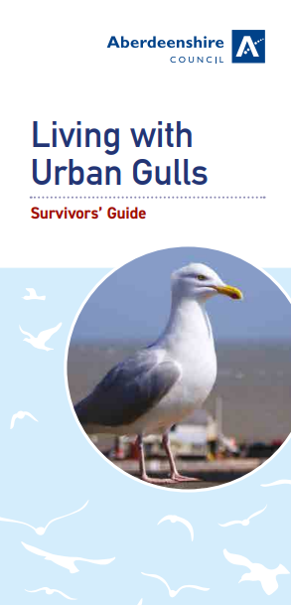
Handy advice
RSPB
Gulls and Seagulls | Wildlife Advice | RSPCA - RSPCA - rspca.org.uk
How To Keep Gulls Away | Deterrents | RSPCA - RSPCA - rspca.org.uk
Guidance - gull management | NatureScot
Living with Urban Gulls (aberdeenshire.gov.uk)
or contact Environmental Health for advice at
Environmental@aberdeenshire.gov.uk
NatureScot
Aberdeenshire Council

